Slide 1
Yea
International Studies and Programs
Faculty International Field Seminar:
16 May – 2 June 2014
“Teaching Africa Today: A field based study of Uganda and Rwanda’s social and environmental diversity”
Harper College
22 August 2014

Slide 2
M
International Studies and Programs
Overview
I. Genesis of Faculty International Field Seminar
II. GEC and Field Program Implementation
III. Faculty Projects & Experiences
Individual Faculty projects

Slide 3
International Studies and Programs
Genesis of the Faculty International Field Seminar
Faculty Development programming:
Infuse This! International Curriculum Infusion workshops
Global Gurus Hangout
International Education Summit
Internationalization Plan 2012-16
College Operational Plan 2013-14
Notes:
Operational Plan Goal category:
Diversity: “Create a campus climate that is supportive of cultural differences and respectful of all constituents.”
Goal: that global education is being infused into curricula and the student experience.
Identify global region(s) for a three-year educational focus.
International Committee: Africa 2013-2016
Launch international faculty development program and design 10 curricular infusion projects.
2013-14: Uganda/Rwanda Faculty International Seminar
Complete review of and update study abroad guidelines for safety and legal clearance.
Accomplished Dec 13 with revisions Feb 14
Hold dialogue with faculty groups on the importance of global education.
IE Summit
Global Gurus Hangout
Global Learning Outcomes working group
GLO course mapping group

Slide 4
M
International Studies and Programs
Three-year regional focus:
1st year: Faculty International Field Seminar
2nd year: Student overseas experience
3rd year: Faculty Exchange (Fulbright)
Regional Focus 2016-20: Southeast Asia
(in collaboration with Center for Southeast Asian Studies at NIU)

Slide 5
International Studies and Programs
Graduate Equivalent Course (GEC) and Field Program Implementation
Mukila Maitha
Co-Leader and Instructor, Geography

Slide 6
Jp
International Studies and Programs
Faculty Participants:
Richard Middleton-Kaplan, Academy for Teaching Excellence
Patricia Hamlen, Anthropology
Judi Nitsch, English
Judy Kaplow, Humanities
Valerie Walker, Human Services Program
Bhasker Moorthy, Physical Sciences (Astronomy)
Jim Gramlich, Sociology

Slide 7
Hyo;p
Academy for Teaching Excellence
Richard Middleton-Kaplan
Fall 2014:
Human Rights Expo: Oct. 29 from 9 am to 4 pm
Read Around the World: Dinewa Mengestu’s All Our Names Oct. 31 from 12 – 2 pm
Global Gurus Hangout: “Peacebuilding by Women’s Collectives in Rwanda and Uganda” with Valerie Walker,
Nov. 4 from 3:30 – 4:45 pm
Spring 2015:
GEC (3 credits): “Teaching about Human Rights, focus on Rwanda and Uganda: Atrocity, Transitional Justice, and Peacebuilding”

Slide 8
Yea
Academy for Teaching Excellence

Slide 10
At Makarere University: With Dr. Edith Ruth Natukunda-Togboa and Dr. Susan Kiguli

Slide 17
Yea
Anthropology
Patricia Hamlen
Curriculum Infusion Project for Anthropology 101
Exploring contemporary research goals for the understanding of primate behavior with an emphasis on Mountain Gorillas.
Student Learning outcomes:
Understanding of mountain gorilla behavior and ecology
Knowledge of research protocols of primates
Cultivate intellectual curiosity, critical and comparative thinking skills

Slide 18
Background Research: Dian Fossey and The Karisoke Research Center

Slide 19
The Experience: Volcanoes National Park, Rwanda

Slide 20
Dian Fossey Gorilla Fund International

Slide 21
Our first glimpse

Slide 22
Ten feet away…

Slide 23
The Titus Group

Slide 24
The Harper Group

Slide 25
Yea
Anthropology
Plans for Implementation
Fall 2014 Anthropology Display Case Theme:
“Dian Fossey’s Legacy: Can the Mountain Gorilla Survive?
New information updates text for ANT 101
September 3 from 3:30 – 4:45 pm in Z129
“The Preservation and Conservation of Dian Fossey’s Mountain Gorilla: Primate Research or Lucrative Tourism”

Slide 26
Yea
English
Judi Nitsch
Creation of a “Non-Western Literature” course focusing exclusively on East African literature, particularly on Uganda and Rwanda
Establish a collection of Ugandan and Rwandan literature in Harper’s library
Maintain academic connections through shared research and collaboration
Students will be able to
Revise ahistorical perspectives of “Africa” with the rich historical and cultural content of East Africa since 1800
Grapple with historical and literary challenges endemic to East Africa within the larger fields of African history and Anglophone African fiction
Apply postcolonial feminist concepts to the contemporary writing of East African women

Slide 27
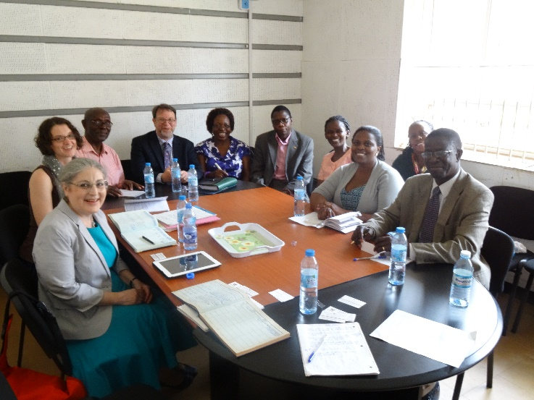
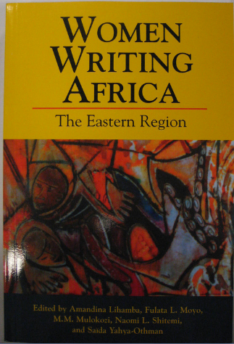
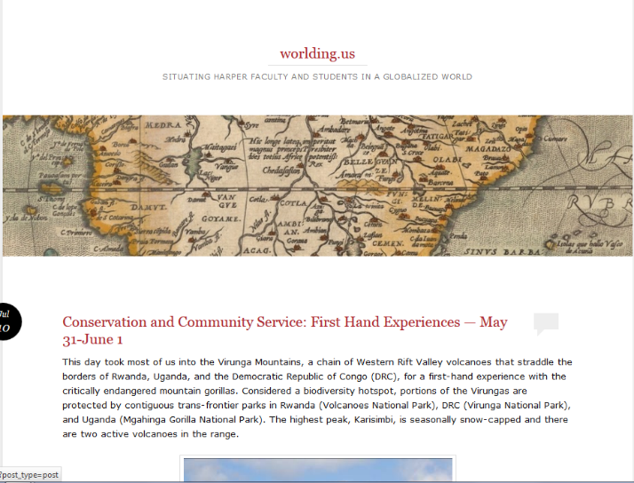
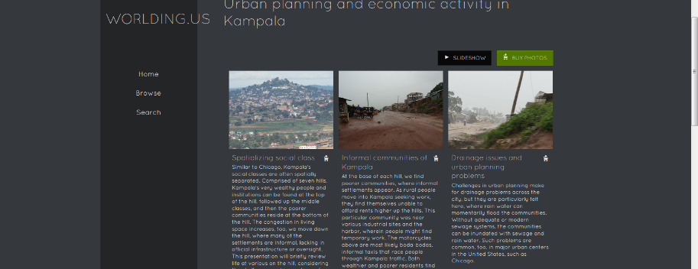
Implementation
Exposing students to women’s writing across East African class, region, and ethnic groups
Ordering texts from Femrite and other national presses, per recommendations from university contacts
Designing a reflective-based course featuring faculty blog posts and photos on publicly-accessible websites
Hosting student symposium on literary analyses (Spring 2015)
Continuing intellectual collaboration with English faculty from Makerere and Butare.

Slide 28
Additional Projects
Establishing shared faculty resources to infuse East African content across Harper’s curriculum
Topic-specific slide shows
Travel blog
Reflective journal assignments
Additional literary and historical resources in Harper’s library
Presentation on “The Third World Woman” for International Education Week
Creation of English-Geography learning community on East Africa for Fall 2015
Guest lecturing for other faculty on East African colonization and postcolonial literature

Slide 29
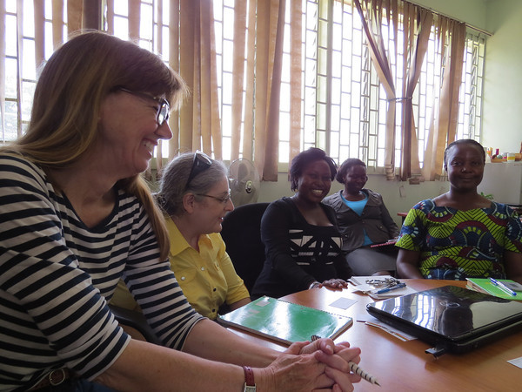
Yea
Humanities
Judy Kaplow
Project Objectives:
Access to information!
Discussions with African
colleagues and scholars
Direct experiences, opportunities to observe
first-hand:
Meeting with Mr. Festo Karwemera at Lake Bunyonyi
Umuganda experience
Tours of markets, cities, museums, etc.
Notes:
Information sources include two volumes of journal articles on folktales and oral traditions in Uganda, produced by Ugandan scholars, information on source materials by Elder Karwemera, English-language versions of Rwandan folktales translated and provided by Dr. Abubaker Keterrega, etc..

Slide 30
The Trip’s Contributions to Student Outcomes
Student outcomes:
Relevant samples I brought back:
Increased understanding of several significant African cultures
Improved understanding of African history and modern cultural challenges and successes
Cross-cultural communications
English translations of Rwandan folktales, Ugandan poetry, Ugandan and Rwandan carvings, DVD on “Umuganura”, musical instruments, etc.
Information and images on Rwanda genocide and aftermath: political, and cultural responses. Ugandan political conflicts between Buganda king and present government
Possible internet links with Makerere students (Dr. Kigali Susan)

Slide 31
Other Applications
Using traditional hero models in forging and maintaining political movements
Tomlinson Hill – The past and future of American race relations in context of gacaca courts of Rwanda
Umuganda – The use of public service mandates and the ideal of Ubuntu in the recreation of national identity
Modern African literature, languages, and the colonial legacy
African infrastructure, African traditions of leadership, and first world investment
Agriculture, Ubuntu, and the environment
Notes:
Author of Tomlinson Hill – Chris Tomlinson

Slide 32
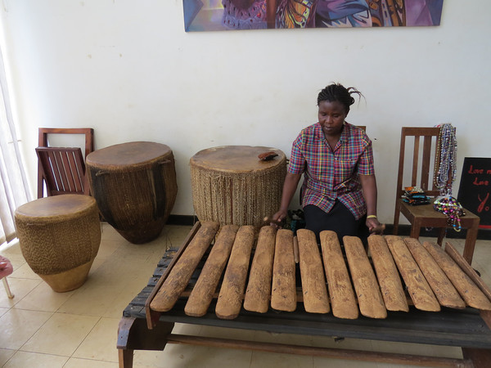
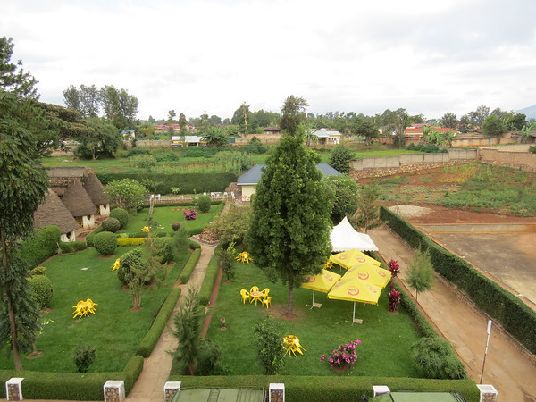
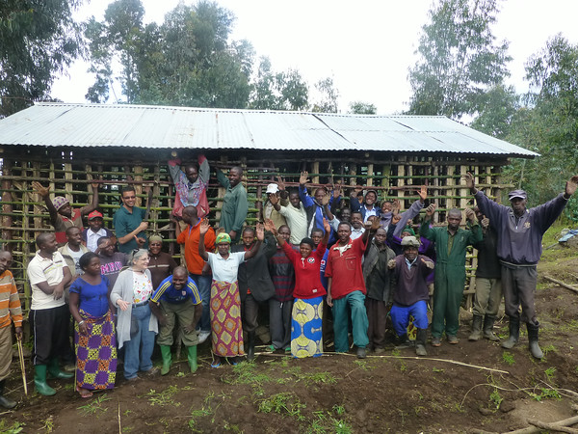
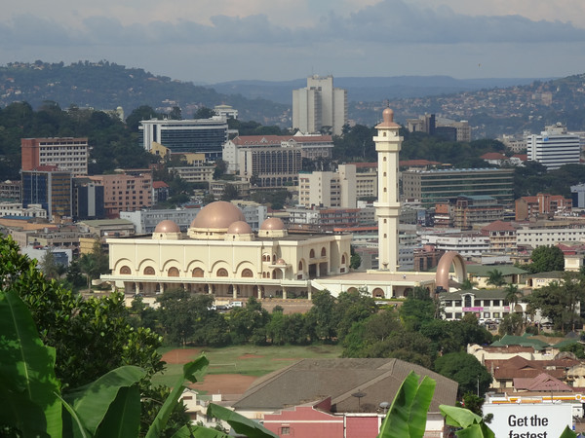
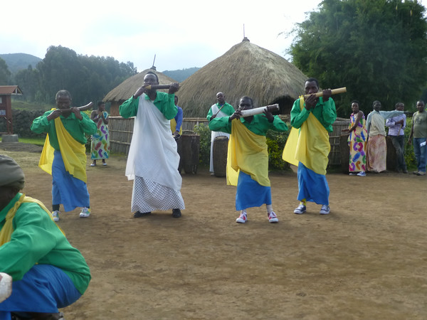
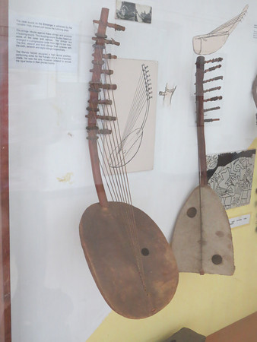
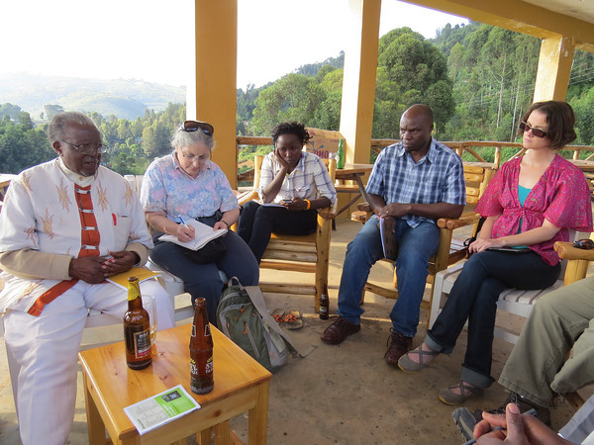
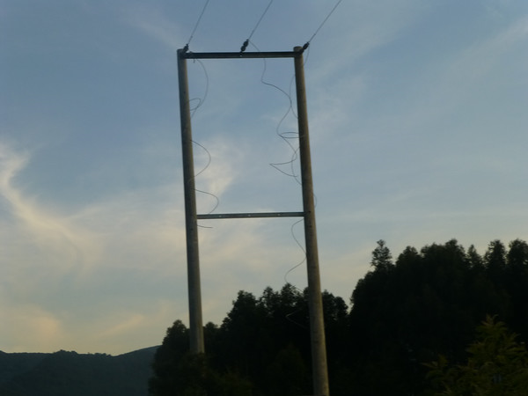

Slide 33
Yea
Human Services Program
Valerie Walker
Field Study Question: An Exploration of Culturally Responsive Human Service Provisions in Uganda and Rwanda
Women and Girls’ Issues in Uganda i.e. health, education, intimate violence, sexual exploitation and economic development
Healing/Recovery issues and relevant organizations for women in a post-genocide community development framework in Rwanda

Slide 34
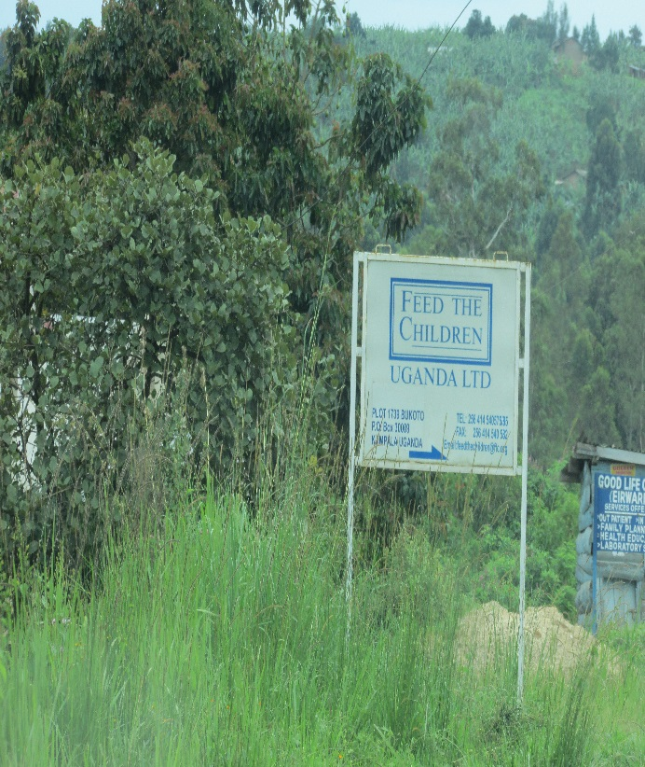
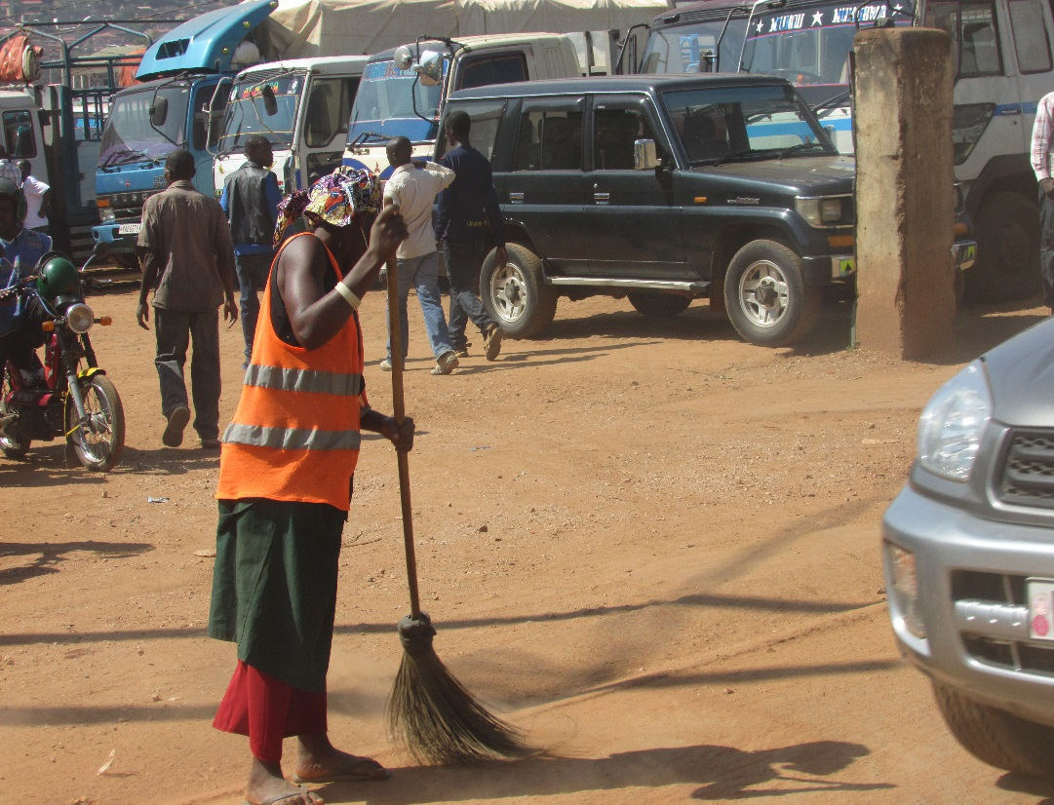
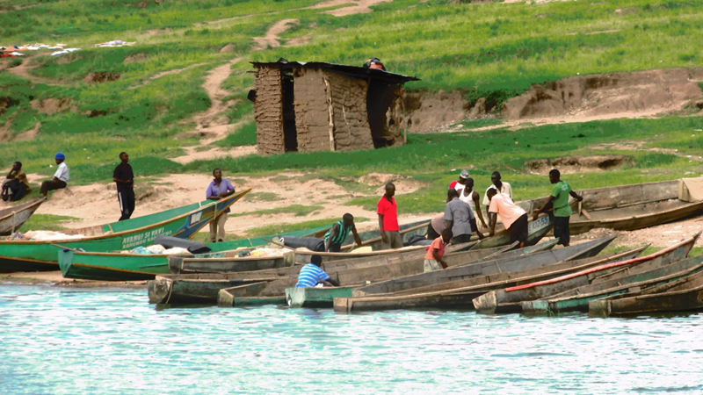
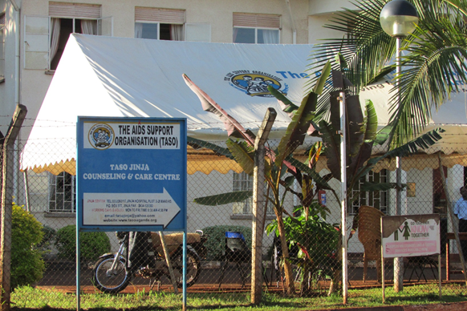
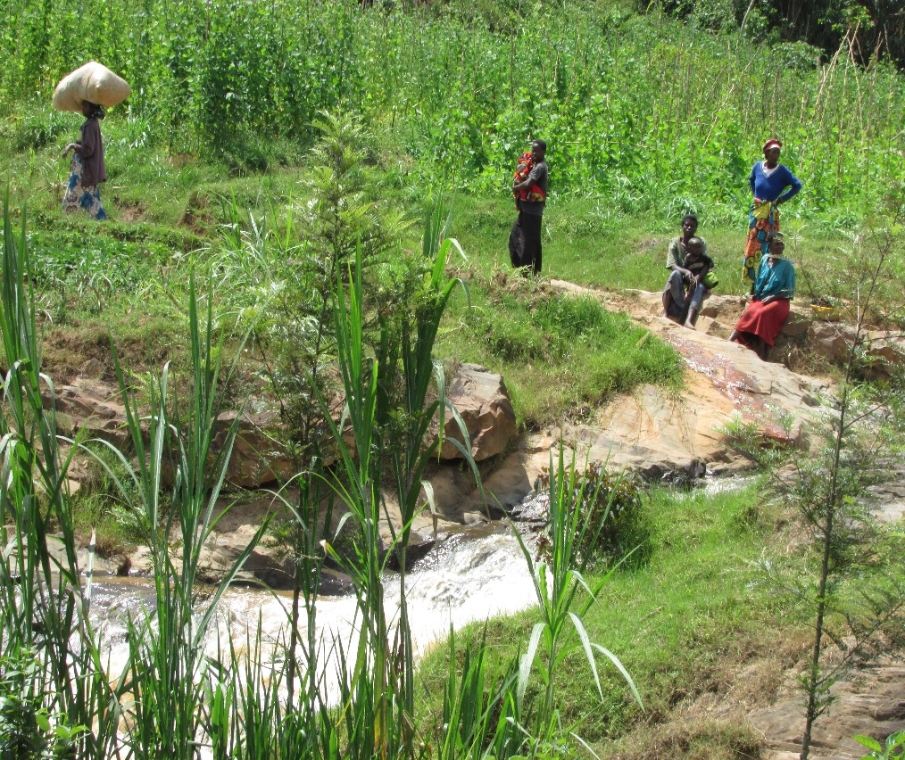

Slide 35
Curriculum Infusion: HMS 121: Multiculturalism in Human Services
The course has an international perspectives unit on identity development of first generation community members, human rights, genocide, refugees, social trauma, community psychology and development, and inter-faith dimensions for providing human services.
“The Human Services Response” Module:
“Culturally Responsive Service Delivery for Victims of Ethnic Conflict, Genocide and Mass Violence”
Related Student Outcomes:
2. demonstrate self-reflection through analysis of personal cultural values, belief systems and biases.
4. identify characteristics of diverse value systems and world views.
5. identify behavioral and psychological responses of vulnerable populations to the impact of cultural and institutionalized oppression.
6. describe the basics of ethnographic interviewing.
7. identify the barriers to cross-cultural counseling, and identify development of multicultural competencies.

Slide 36
HMS 121 ‘Multiculturalism’ Infusion
Integrative Learning Components:
Examples of Collaborations & Community Partner Sites
Case studies provided by viable Human Services organizations that provide social advocacy and health and human services “on the ground” in international and U.S. communities
Guest Speakers and Panelists, involving personal testimony, education on career pathways
Assignments related to Resource Mapping internationally-serving Advocacy and Human Services organizations
Selected testimonies from “Teaching Africa Today” seminars, panels, presentations and literature review
UGANDA: Makarere University School of Social Work, Nzamisi Training Institute for Social Development (Social Justice Education Programs), Olwal School in Gulu Networking with Makarere student, Zimu Foundation (Uganda and Illinois)
RWANDA: Center for Conflict Management, National University of Rwanda; Inzozi Nziza Dreams
CHICAGOLAND and U.S.: Pan-African Association, Interfaith Immigration Coalition, Dr. Michelle Martin (International Human Services Educator & Practitioner), Audrey Musiimenta (Ugandan Consul in Chicago)

Slide 37
Additional Course Infusions & Integration
HMS 101: Intro to HMS
HMS 112 : Group Work
“International Human Services” Module:
Critical Review of Public Vs Private Sector HMS Roles
Guest Presentations by Service Providers & Refugees
Commonalities & Differences between Immigrants and Refugees
Impact of Faith-based organizations: From Colonialism to Service
Social Policy Advocacy, Macro-level Human Services
Human Services Worker Roles, Case Scenarios and Group Services
Health Prevention-Education Groups in Fishing Villages in Uganda (Kizinga River photo), provided by Human Services-prepared “Community Health Workers”
INZOZI NZIZA Women’s Cooperative, Provides employment, post-genocide counseling services, prevention-education and community based drumming to women in Rwanda

Slide 38
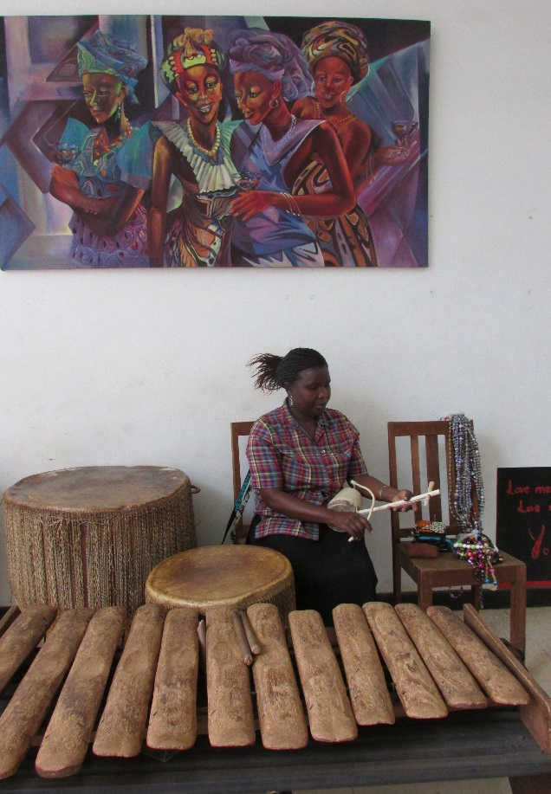
HMS Club Focus Area for 2014-15:
Roundtable panels and educational components on community development, health and human services, and human rights issues
Access new partnerships with universities and community organizations into service learning components
Connections with our Human Services Club to communities and relationships in Uganda or Rwanda including
paired dialogues between students
selection of human services organizations as donations recipients
invitations of persons who have direct experience with immigrant or refugee roles for “courageous conversations”
FOCUS ON THE EXPERIENCE OF IMMIGRANTS AND REFUGEES

Slide 39
HMS Program Development, Harper & Community Contributions
Presentations to Career Programs Division, Community Partner Sites & Faith Organizations
HMS Advisory & Faculty Meeting regarding International Human Services Issues infusion into curriculum & field sites
Resources for HUMAN RIGHTS EXPO (ISP and HMS)
Facilitation of ISP Session on Women & Peace-Building
COMMUNITY HEALTH WORKER Certification – Initiated in Collaboration with Health Careers Program and Health Education & Kinesiology Department, involves renewed partnerships with local HMS partner sites as well as diverse-serving organizations

Slide 40
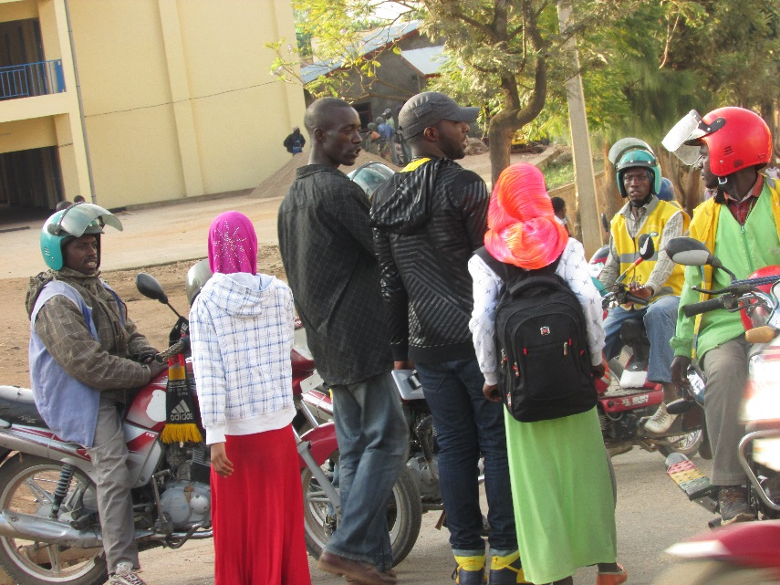
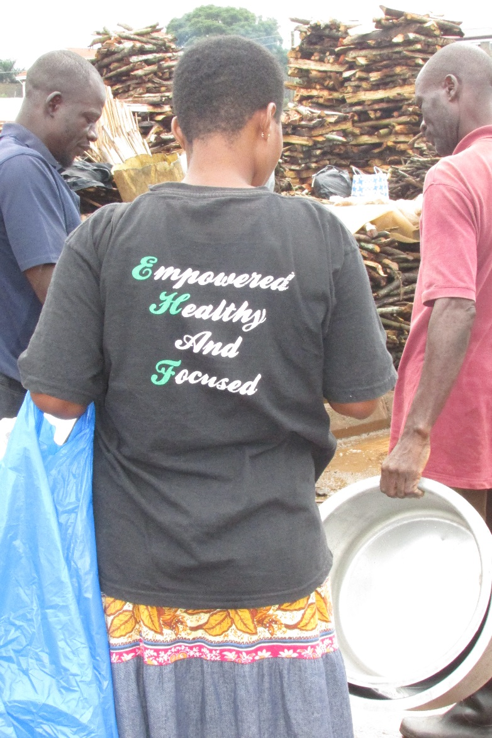
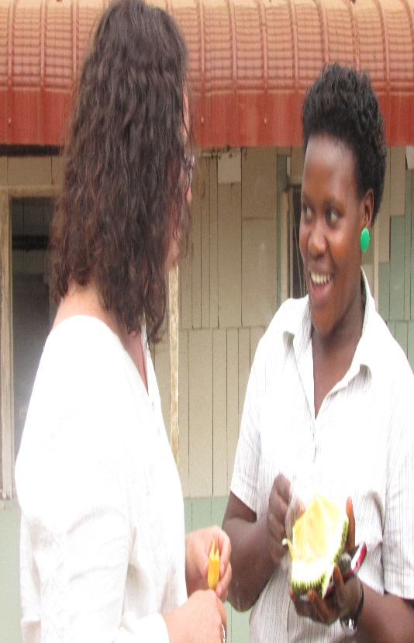
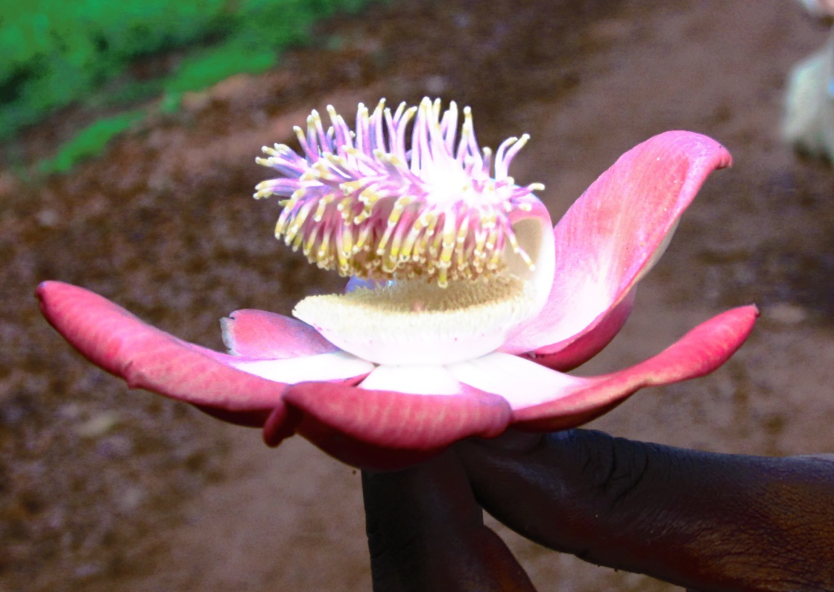

Slide 41
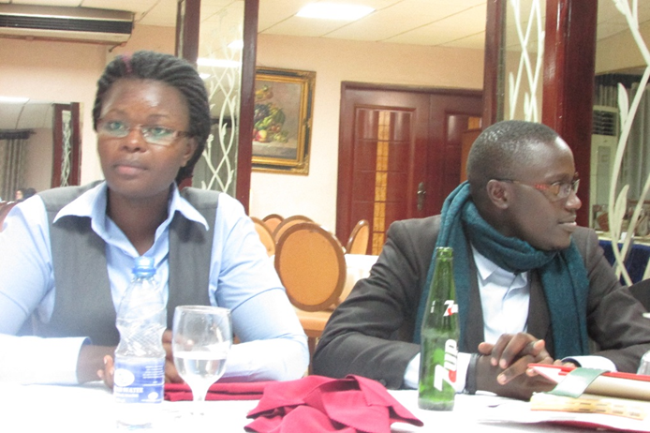
Benefits of the Faculty International Seminar
Partnerships and Collaborations
Authentic Conversations and Connections
Increased Resources for Integrative Learning
Increased Empathy and Knowledge
Rededication to Global Scope for HMS Education
Making It Up to the Top on the Gorilla Trek

Slide 42
Yea
Physical Sciences: Astronomy
Bhasker Moorthy
Infuse ethnoastronomy, archaeoastronomy, and contemporary astronomy from Africa into my courses
Collaborating with counterparts on astronomy education and outreach
Students should demonstrate familiarity with:
Myths and legends about the sky, cosmologies, relationship between astronomy and traditional calendars and festivals, astronomical artifacts
African observatories and contributions by African astronomers

Slide 43
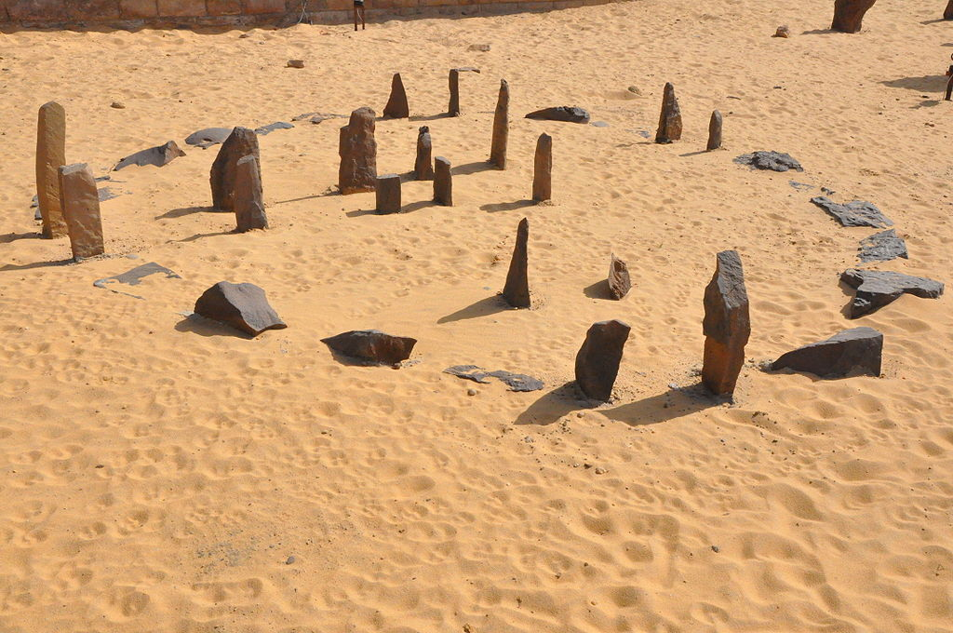
Ethnoastronomy and archaeoastronomy
Nabta Playa
The world’s oldest archaeoastronomy site?
“The Borana Calendar Reinterpreted”
Laurance R. Doyle, Current Anthropology 27 (1986)

Slide 44
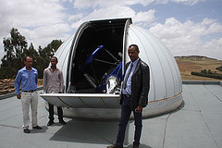
Contemporary Astronomy
Entoto Observatory, Ethiopia
South African Astronomical Observatory

Slide 45
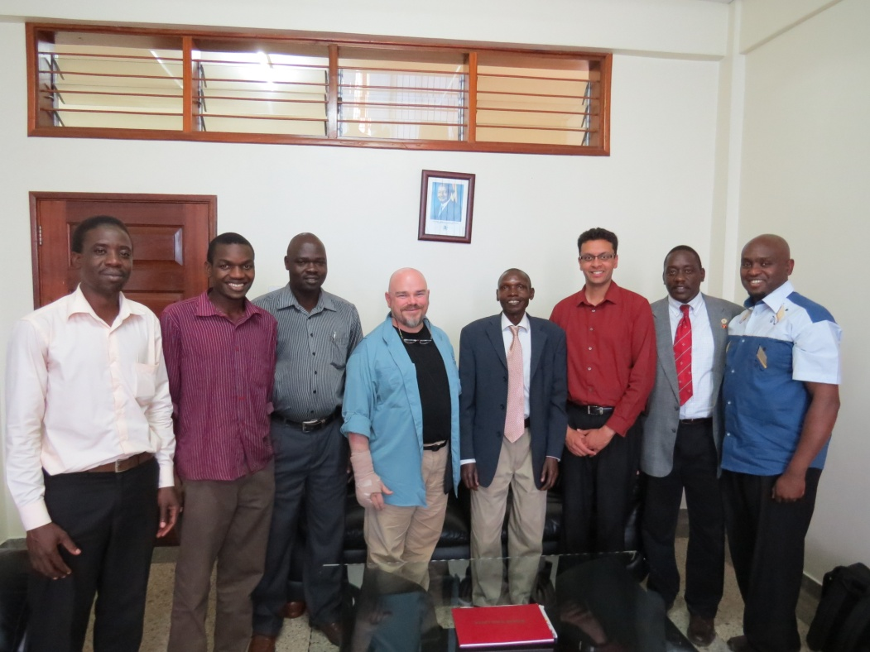
Collaborations
Makerere University geologists admiring rocks donated by Harper College
With our counterparts at Mbarara University of Science and Technology

Slide 46
Yea
Sociology
Jim Gramlich
Curriculum Infusion Project for SOC235 (Sociology of Race and Ethnicity)
Explore the ways in which racial/ethnic categories become institutionalized as well as outcomes
Comparison between US conceptions of race and the nature of group difference in Uganda and Rwanda
Pluralism versus Assimilation

Slide 47
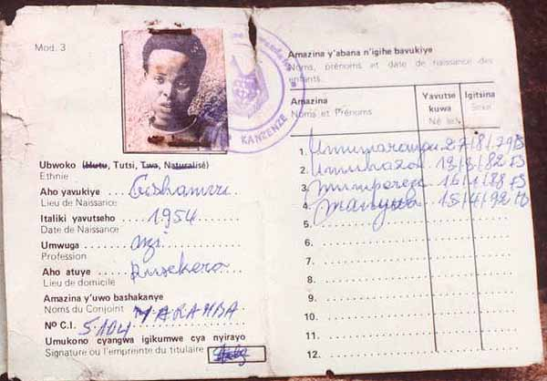
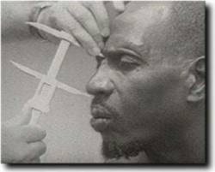
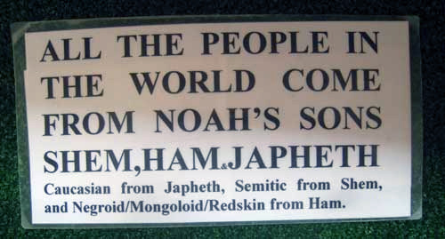
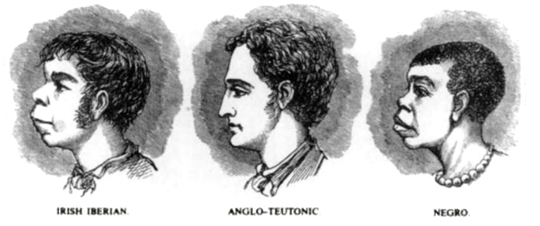
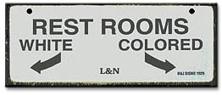
Yea
Sociology

Slide 48
M
International Studies and Programs
Fall 2014 ISP events
International Student Reception: Tuesday,
Sept. 9 from 4 to 6 pm in PAC Lobby
African Lecture Series
Peacebuilding Series: “Conflict, Trauma and Peace”
Global Gurus Hangout
Read Around the World Book Discussion
International Education Week

Slide 49
International Studies and Programs
Merci! Stuutiyi! Gracias! Xie Xie!
Obrigado! Baarka! Shukran! Blagodaria!
Grazie! Danke schoen! Domo arigato!
Gratias agimus! Manana! Hvala! Asante sana!
Khop khun mak! Weebale! Akpe! Diloch yn fawr!
Ngiyabonga! Moran Taing! Murakoze cyane!
Thank You!

